Slide 1


BULLY
COP290 Assignment 2
Submitted by:
Tanish Singh Tak (2020EE10560)
Pranay Shah (2020ME21041)
Avinash Kumar (2016CS10361)

Slide 2
Goal
To spread awareness on bullying through satisfying gameplay
Target audience includes Teenagers and Adults, mainly college students
Awareness of practical ways to deal with bullying

Slide 3
Themes
Impact on Mental Health: Effects of bullying on mental health
The Cycle of Bullying: Exploring how bullying behaviors perpetuate themselves over time, with victims sometimes becoming bullies themselves
Power Dynamics: Highlighting the power imbalances that often underlie bullying situations
Building Resilience: Empower players to build resilience in the face of bullying. Teach them coping strategies, assertiveness, and ways to seek support from trusted adults or friends

Slide 4
Design Choices
We chose to make a plot and theme oriented gameplay instead of adding too many features to the game like Batman: The Telltale Series
Made choices in the game that matter to how you proceed and lead to different endings:
Giving in to the pressure
Willing participation in the acts
Assertiveness to not be swayed and fighting back
These are all choices we put in the game for the player to explore
We chose the Python language to develop our game with the use of pygame library
Our game is a single player desktop based game made with 2D graphics
The social issue remains the core of the game

Slide 5
Features
Fixed State Based Choices: Each choice made by the player has a set outcome
Player Agency: The decisions in a choice is still entirely dependent on the player
Linear Narrative Progression: The storyline progression is linear which offers a focused and purposeful gameplay
Multiple Weapon and Enemies System: Provided multiple weapons for the player with different strengths for bullies with different strengths.

Slide 6
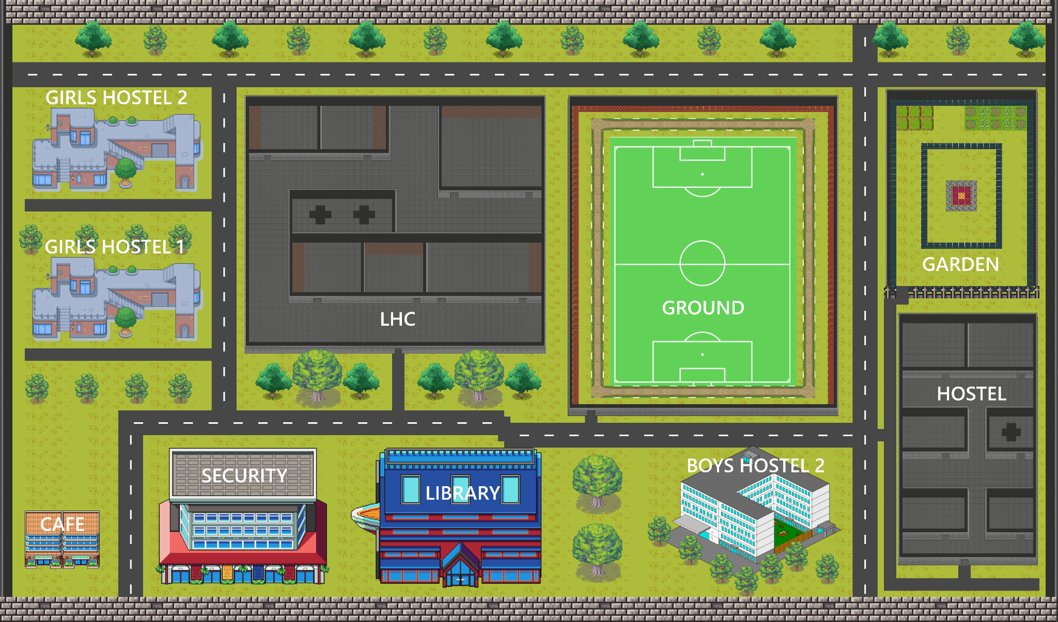
Implementation Highlights
We used python with the pygame library to make our game, which makes the user experience and game more smooth to play
All the assets including the map and sprites were made by us from scratch
We used tiled software to create our complete map

Slide 7






For our characters and different sprites, we used the free online tool PiskelApp to create them.

Slide 8
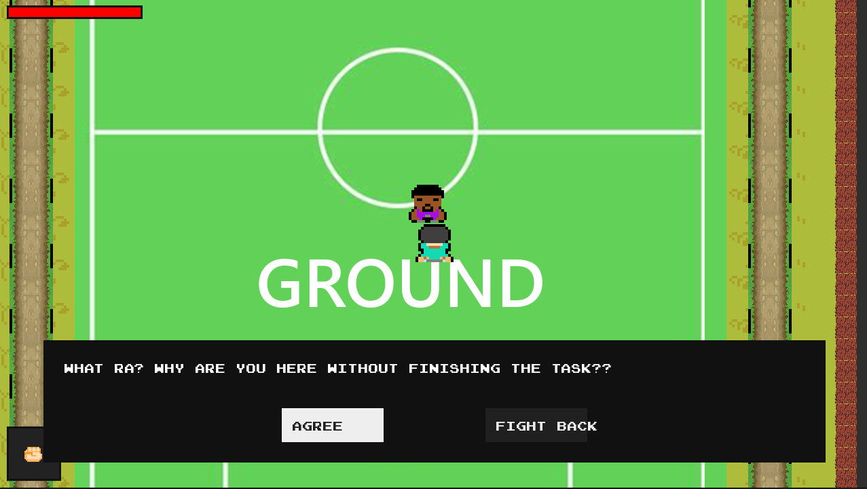
We have created chat boxes with different choices so that a player can choose between a right and a wrong work to do, which will decide their final ending of the game.

Slide 9
For our complete storyline of the game, we have created a story tree type structure which will define the outcomes of the tasks in the game based on the decisions made by the player.
Our story works like a finite state machine in which we have stored the different states of our game based on player’s decision.
We have provided different benefits for taking the right decisions which can help the player in their further gameplay.
For example, in one of the tasks, we have provided speed boost to our player on complaining about the bully to the rightful authority.

Slide 10
Evaluation Metrics
Smoothness: Smoothness while running a game is a must.
No Input Lag: It is a required element to enjoy any game.
Weight of Choices: Choices on how you handle a situation matters, and leads to different outcomes. Which makes for engaging gameplay.
Replayability: Different choices lead to different outcomes, and hence the game can be played multiple times for a brand-new experience of the game.
Good Lesson: We created our storyline such that it can guide the player away from bullying by creating a reward mechanism in game for good decisions
UI: Created the whole UI and graphics of game by scratch to give the feel of the video games played in the childhood of current youth generation

Slide 11
